Slide 1
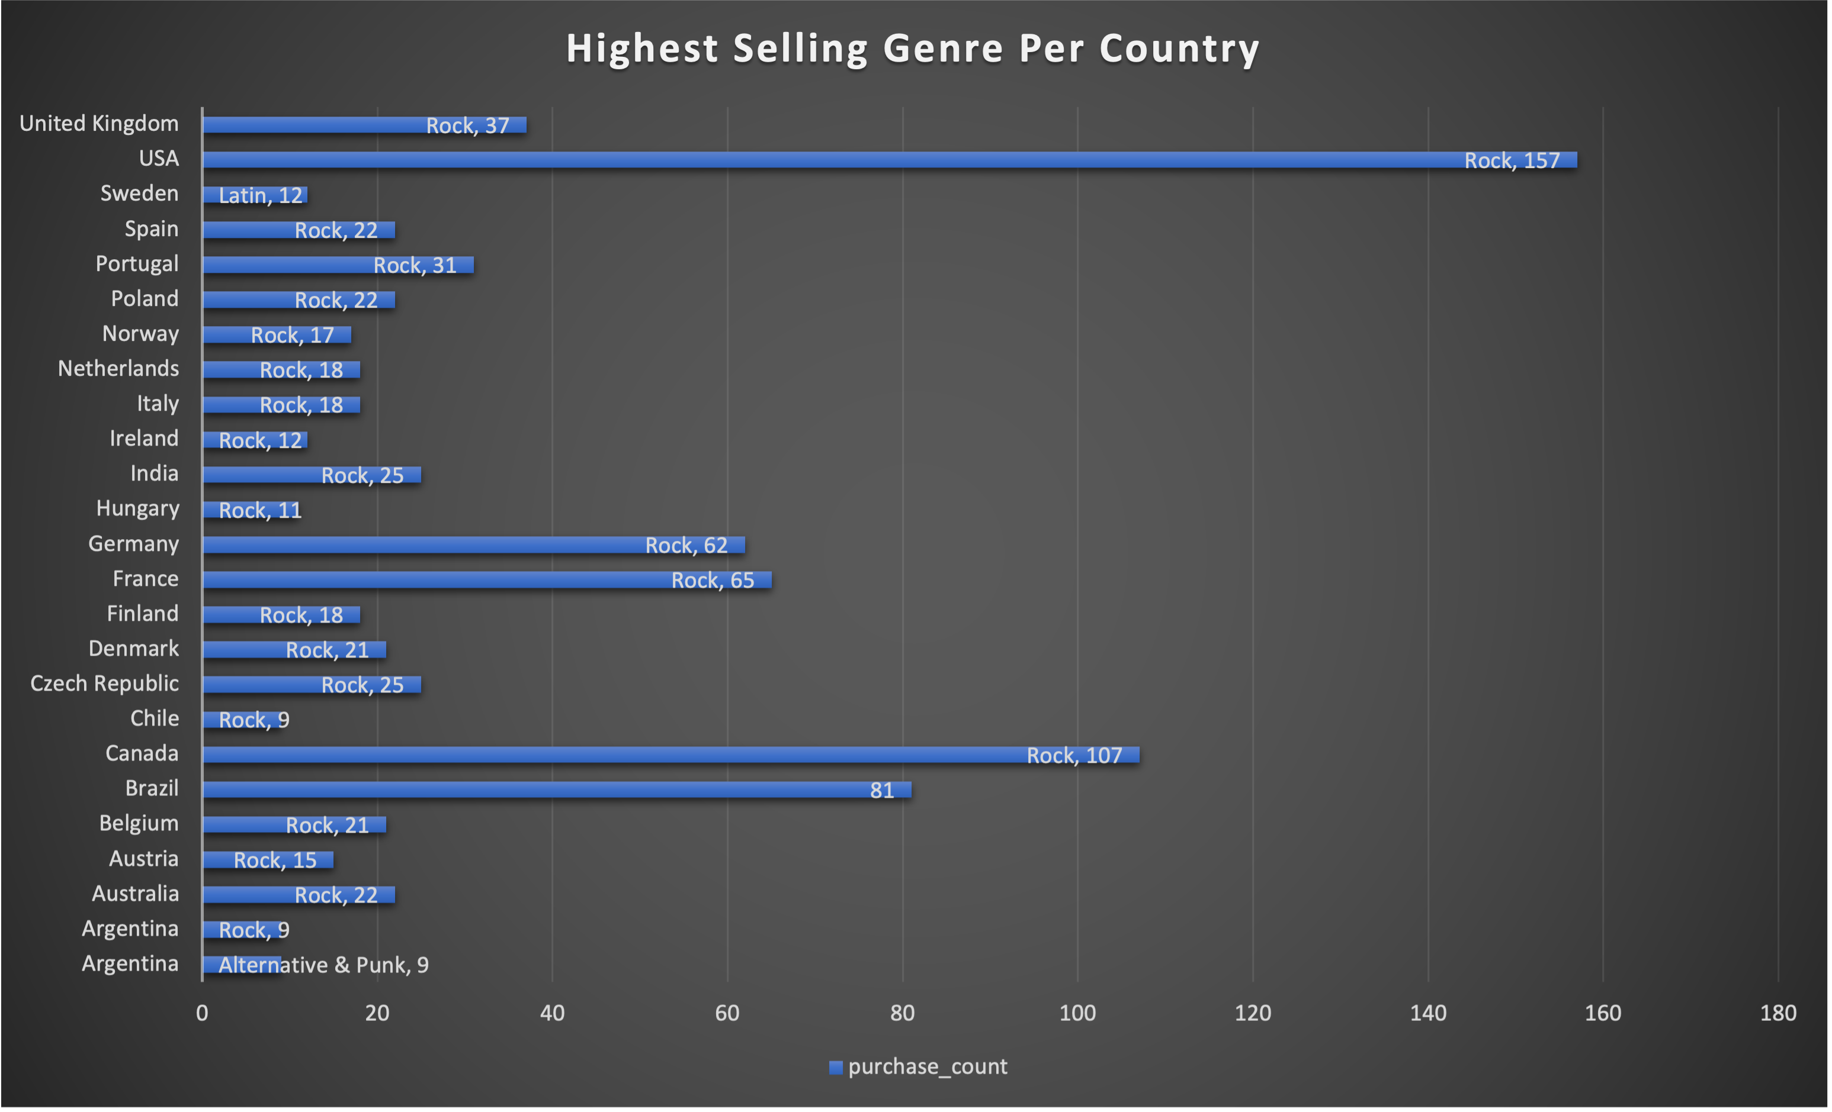
Which Genre Was the Highest Selling Per Country?
- Rock was the highest selling genre per country in every country besides Sweden. Argentina is tied for Rock and Alternative & Punk with 9 sales.
Country

Slide 2
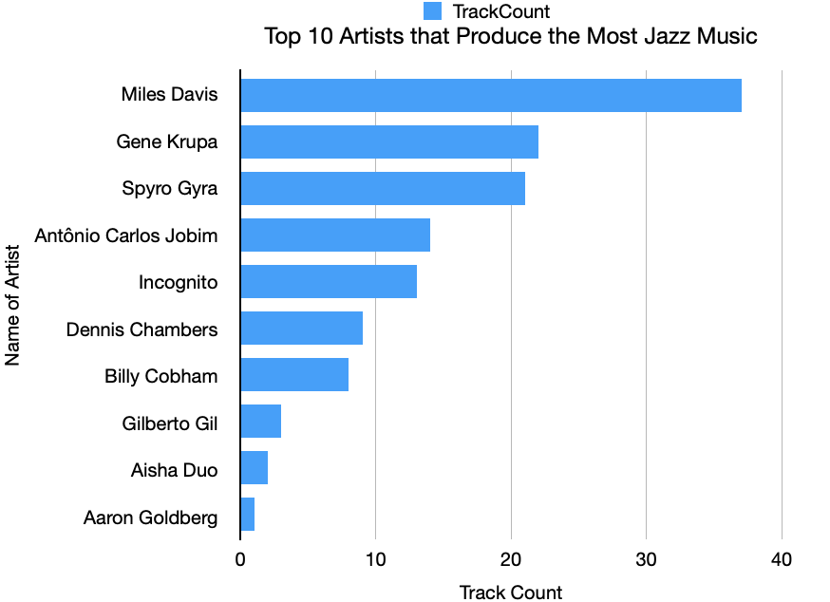
Which Artist Produces the Most Jazz Music?
Miles Davis produces the most Jazz music with 45 tracks.

Slide 3
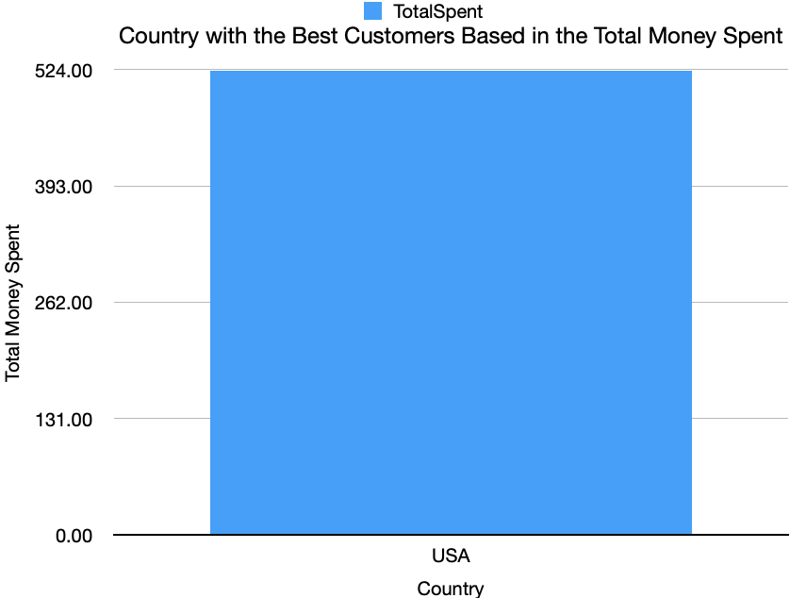
Which Country has the Best Customers?
The USA has the best customers because they spend the most money.

Slide 4
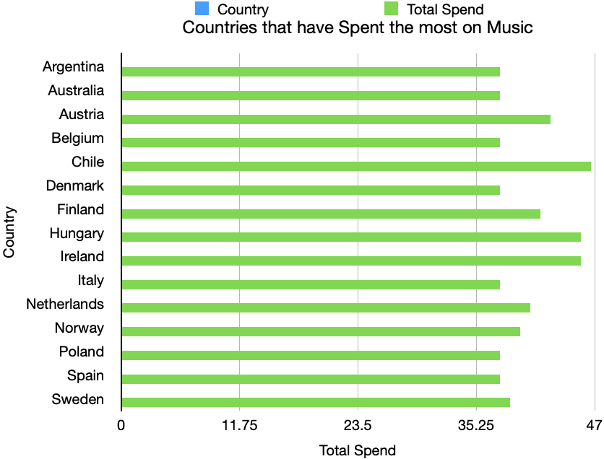
Which Country Spends the Most on Music?
Luis Rojas from Chile spends the most money on music, spending $46.62.

